Slide 1

Working
with
Blazor
Components
Daniel Villamizar
Senior Cloud Solutions Architect - MVP
@danielvillamizara – https://www.linkedin.com/in/danielvillamizara/

Slide 2


Module
overview
Doing more with components
Adding navigation
Using RenderFragment
Loading components dynamically
Handling errors in components
Using built-in components

Slide 3
Doing
More
with
Components

Slide 4

Displaying
Data
in
a
Component
UI
target
Technically
data
binding:
one-way
data
binding
from
source
to
(UI)
EmployeeDetail.razor.cs
EmployeeDetail.razor
<h1
class="page-title">
public
public
string
string
FirstName
{
get;
set;
}
Details
</h1>
for
@FirstName
@LastName
LastName
{
get;
set;
}

Slide 5
Changing
the
Access
Modifier
EmployeeDetail.razor.cs
EmployeeDetail.razor
<h1
class="page-title">
private
private
string
string
_firstName;
_lastName;
Details
</h1>
for
@_firstName
@_lastName

Slide 6
Dotting
into
the
Properties
EmployeeDetail.razor.cs
EmployeeDetail.razor
<h1
class="page-title">
Details
for
@Employee.FirstName
@Employee.LastName
</h1>
public
Employee
Employee
{
get;
set;
}

Slide 7

Nesting
Components
Components can include other
components
Declared in HTML

Slide 8
Nesting
Components
May
require
@using to
be
added
EmployeeOverview.razor
PageHeader.razor
@page
"/employeeoverview"
<h1>@PageTitle</h1>
<PageHeader></PageHeader>

Slide 9

Components live in a namespace
Root namespace + folder
-
Typically project name
May require @using to be added when using
the component

Slide 10
@using
@using
@using
Microsoft.AspNetCore.Components.Forms
Microsoft.AspNetCore.Components.Routing
Microsoft.AspNetCore.Components.Web
@using
BethanysPieShopHRM.App.Components
Using the _Imports.razor File

Slide 11
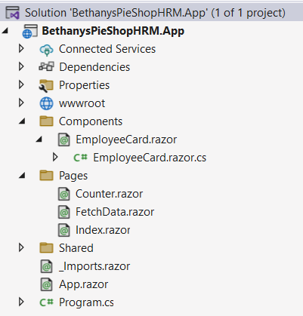
Component
Namespaces
@using
BethanysPieShopHRM.App.Components

Slide 12

Component
Parameters
Parameters are used to pass data between
components
Use the [Parameter] attribute
Parameter can be simple or complex type

Slide 13
Accepting
a
Parameter
<h3>@Name</h3>
@code
{
[Parameter]
public
string
Name
{
get;
set;
}
=
string.Empty;
}

Slide 14
<EmployeeCard Name="Gill
Cleeren"></EmployeeCard>
Invoking a Component with a Parameter

Slide 15


Demo
Creating the employee card component
Passing data using [Parameter]

Slide 16
Working
with
Events
in
Components
@on{Dom
Event}="Delegate"
<button @onclick="SaveEmployee">Save</button>
@code {
private void SaveEmployee()
{
//save the employee to the backend
}
}

Slide 17
<button
@onclick="ShowLocation">Show</button>
@code
{
private
{
void
ShowLocation(MouseEventArgs
e)
}
}
Using
the Default Event Arguments
@onclick passes MouseEventArgs
@onkeydown passes KeyboardEventArgs

Slide 18
Using
Lambda
Expressions
@for
{
(int
i
=
1;
i
<
10;
i++)
var
buttonNumber
=
i;
<p>
<button
@onclick="@(e
=>
ShowLocation(e,
buttonNumber))">
Button
</button>
</p>
@i
}
@code
{
private
{
void
ShowLocation(MouseEventArgs
e,
int
buttonNumber)
}
}

Slide 19
Using
EventCallback
Parent Component
Parent event
^{handler} Child component
Invoke event callback

Slide 20
<button
@onclick="TriggerCallbackToParent">Show</button>
@code
{
[Parameter]
public
EventCallback<MouseEventArgs>
TriggerCallbackToParent
{ get;
set;
}
}
Using EventCallback in the Nested Child Component

Slide 21
<ChildComponent
TriggerCallbackToParent="ShowPopup"></ChildComponent>
@code
{
private
{
...
}
void
ShowPopup()
}
Reacting to an EventCallback
in the Parent Component

Slide 22

Working
with the
Component
Lifecycle
Events which are triggered automatically at certain points
Write code in overrides to hook into these

Slide 23
Important
Lifecycle
Events
OnInitialized() OnInitializedAsync()
OnParametersSet() OnParametersSetAsync()
OnAfterRender() OnAfterRenderAsync()

Slide 24
protected
{
override
void
OnInitialized()
//Initialization
code
for
the
component
}
Overriding a Lifecycle Event

Slide 25
Demo
Creating the Quick View popup
component

Slide 26
Adding
Navigation

Slide 27
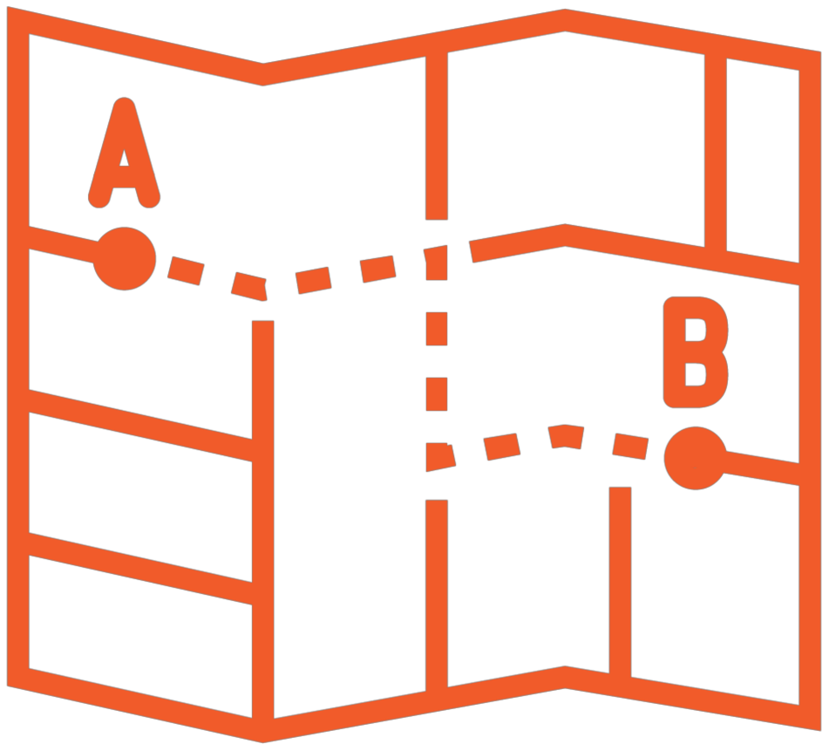



Navigating
in
Blazor
Applications
Router
in App.razor is starting point
@page
directive enables
routing
to
the
component
Can accept parameters
Use NavigationManager for code-based navigation

Slide 28
Router
in
App.razor
<Router
AppAssembly="@typeof(App).Assembly">
<Found
Context="routeData">
<RouteView
</Found>
<NotFound>
RouteData="@routeData"
DefaultLayout="@typeof(MainLayout)"
/>
<h1>We
can't
find
your
page...</h1>
</NotFound>
</Router>

Slide 29
@page
"/employeeoverview"
A Component We Can Navigate to

Slide 30
@page
@page
"/employeeoverview“
"/employeelist"
Multiple Page Attributes

Slide 31
@page
"/employeedetail/{EmployeeId}“
[Parameter]
public
string
EmployeeId
{
get;
set;
}
Adding Route Parameters

Slide 32
@page
"/employeedetail/{Id:int}“
[Parameter]
public
int
Id
{
get;
set;
}
Adding a Constraint

Slide 33
[Parameter]
[SupplyParameterFromQuery(Name
=
"id")]
public
string
EmployeeId
{
get;
set; }
SupplyParameterFromQuery
Specify that value can come from query string
Name property can be used to define a different
query parameter

Slide 34
[Inject]
public
NavigationManager
NavigationManager
{
get;
set;
}
NavigationManager.NavigateTo($"/employeedetail/{selectedEmployee.EmployeeId}");
Triggering Navigation from Code
NavigationManager is injected here using dependency injection

Slide 35
Demo
Adding the employee details component
Navigating to the details page

Slide 36
Using
RenderFragment

Slide 37
Setting
the
Content
<ProfilePicture>actual-image-name</ProfilePicture>
ProfilePicture
actual-image-name

Slide 38
Using
RenderFragment
<div
class="profile-picture">
@ChildContent
</div>
@code
{
[Parameter]
public
RenderFragment?
ChildContent
{
get;
set;
}
}

Slide 39

Naming
is
everything!
The RenderFragment property must be named ChildContent!

Slide 40
Demo
Using RenderFragment to pass content

Slide 41
Loading
Components
Dynamically

Slide 42

Using
Dynamic
Components
_{MENU} Bethany’s Pie Shop HRM
You have 3 new messages
Staff: 15 employees
Sunny, 25°C

Slide 43
<DynamicComponent
Type="@type"
/>
@code
{
private
Type
type
=
...;
}
Using DynamicComponent
Possible to pass in parameters too
Can render a dynamic UI if used in a loop

Slide 44
Demo
Loading widgets on the home page

Slide 45
Handling
Errors
in
Components

Slide 46
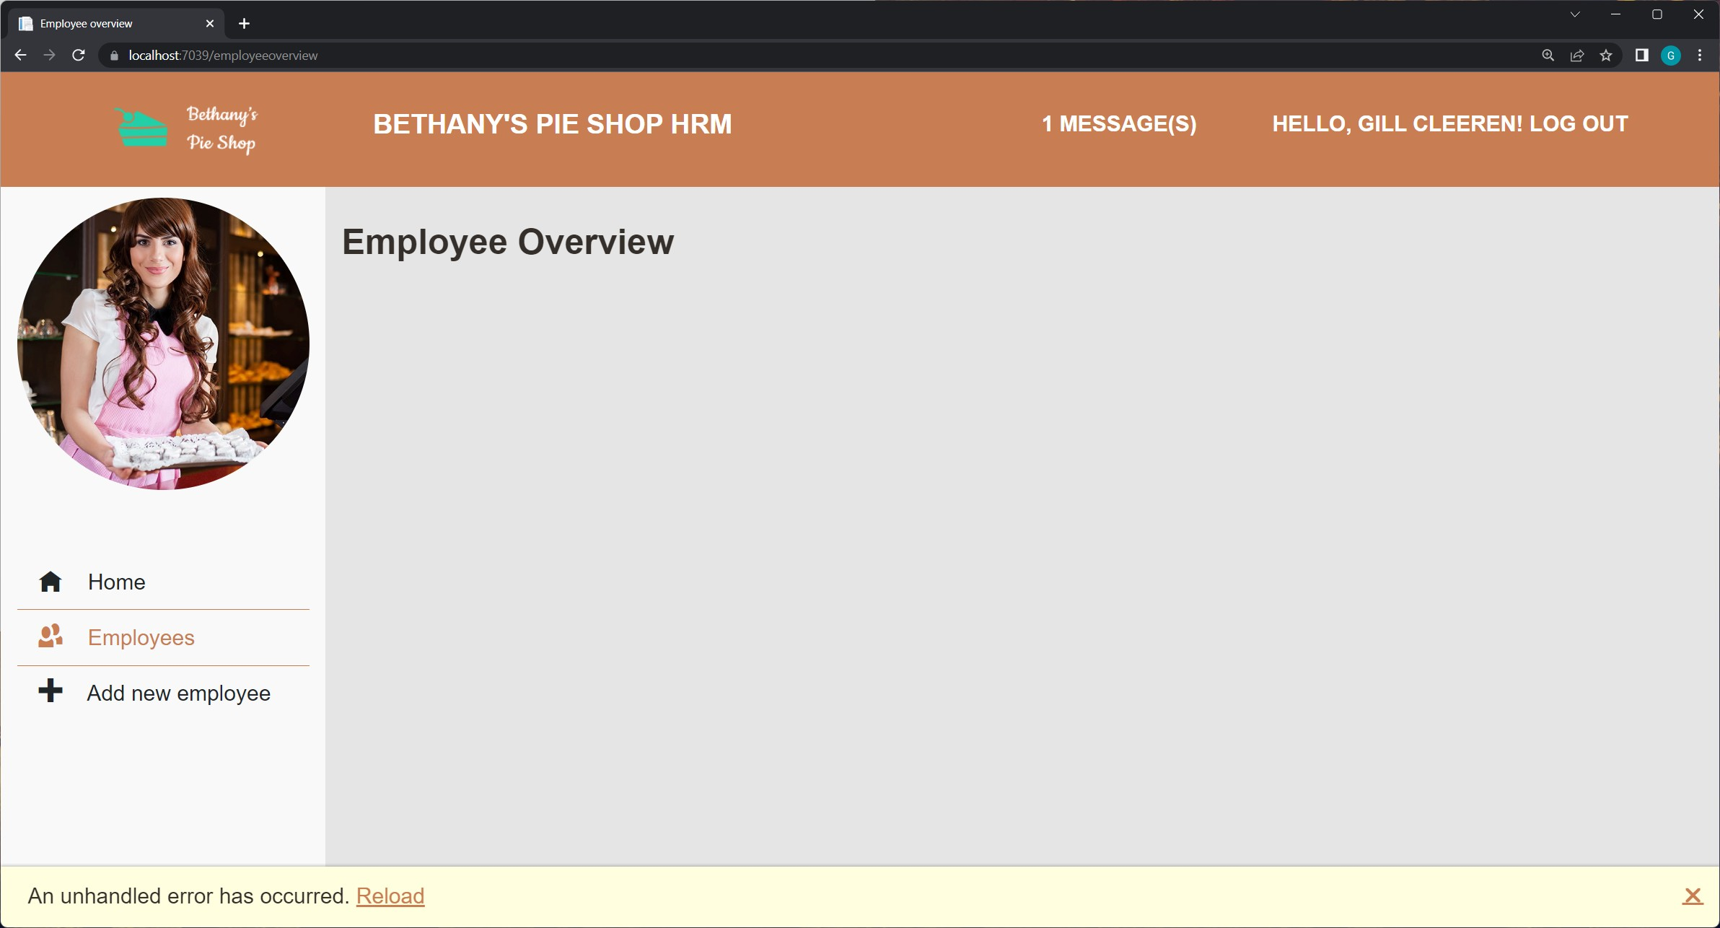
The
Default
Exception
Handling
in
Components

Slide 47


Default
Exception
Handling
First name Last Name
Bethany Smith
Gill Cleeren
John

Slide 48
Adding
Error
Boundaries
First name Last Name
Bethany Smith
Gill Cleeren
John
John

Slide 49
<ErrorBoundary>
<EmployeeCard
</ErrorBoundary>
Employee="employee"></EmployeeCard>
Using Error Boundaries

Slide 50
<ErrorBoundary>
<ChildContent>
<EmployeeCard
</ChildContent>
<ErrorContent>
Employee="employee"></EmployeeCard>
<p>Something
</ErrorContent>
</ErrorBoundary>
went
wrong!</p>
Showing a Specific Error

Slide 51
Demo
Adding error boundaries

Slide 52
Using
Built-in
Components

Slide 53
Everything
is
a
component.

Slide 54
Built-in
Components
App
Router
DynamicComponent
ErrorBoundary
NavMenu
NavLink

Slide 55

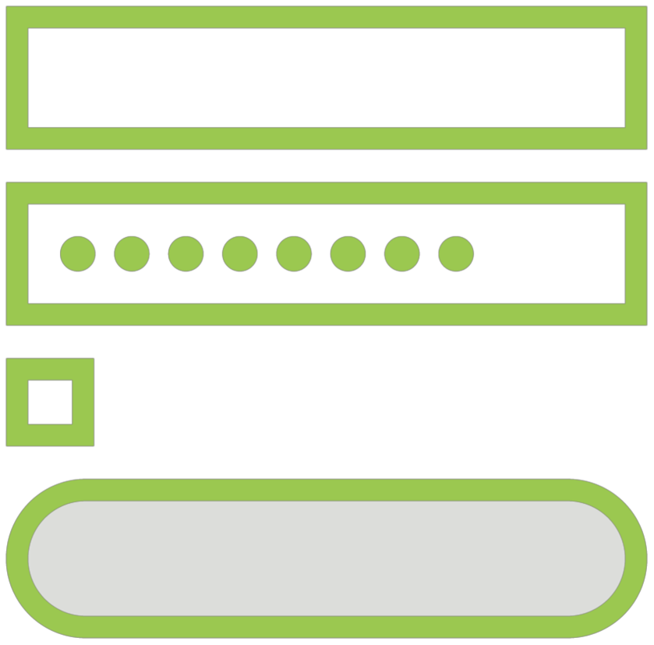

Built-in
Components
Authentication
Forms
Standalone: PageTitle…

Slide 56
Demo
Setting the title of the page through Blazor

Slide 57
Components can handle events and bind
data
Parameters allow components to communicate
Navigation requires @page and is handled
by Router component
Components can be rendered dynamically
Error boundaries allow catching errors within a component
Blazor comes with a set of built-in
components
Summary

Slide 58
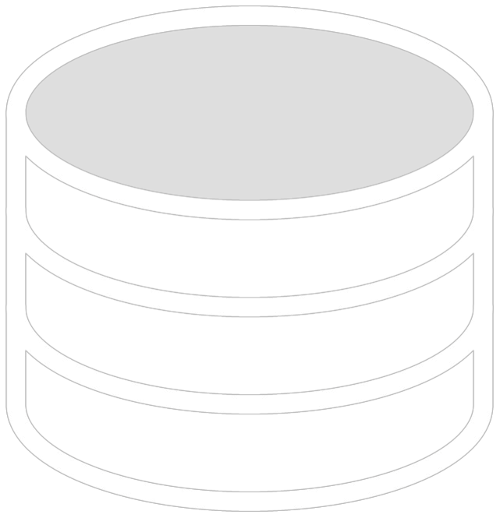
Up
next:
Accessing
real
data
using
an
API

